Slide 1
Latent Semantic analysis(LSA)
DS4BME Final Project
Yiyuan Zhang

Slide 2
Why LSA?
Topic models – to uncover the hidden variable that governs the semantics of the documents
To find topics and represent the documents with them
Application: 1. term-based search 2. recommendation based on similarity 3. find synonym(TOEFL) 4. other data tasks
Difficulties: 1. Synonymy 2. Polysemy

Slide 3
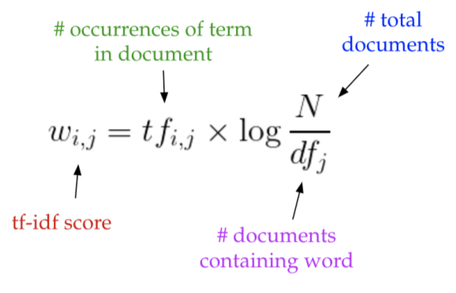
How to do LSA
First, generate word-document matrix.
Second, perform TF-IDF (term frequency-inverse document frequency) to transfer the word-document matrix.

Slide 4
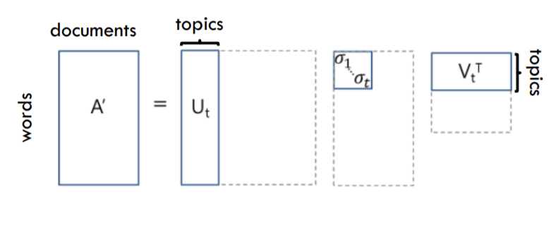

LSA How to (cont.)
Third, dimensional reduction using partial SVD.
Last, plot the vectors.

Slide 5
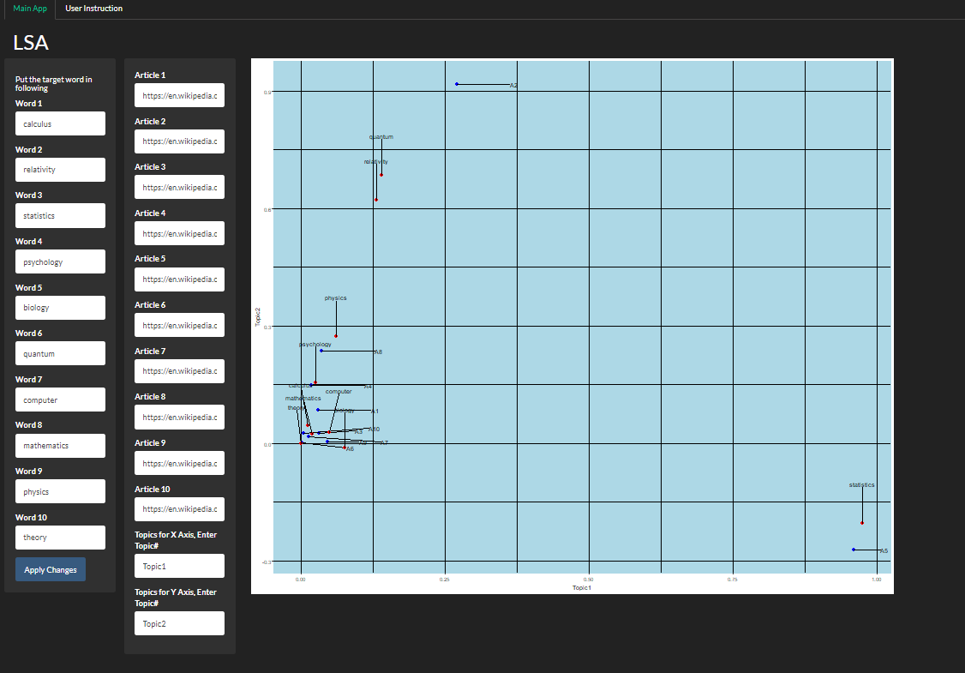
APP Demo: Interface

Slide 6
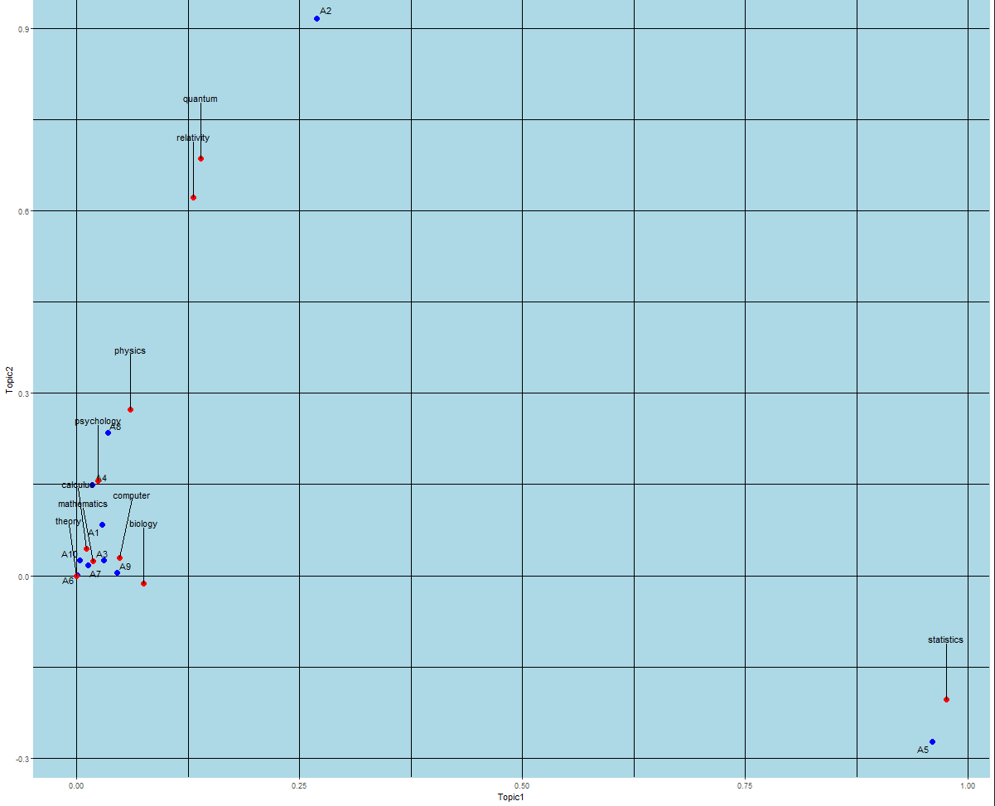
Topic1 vs. Topic2

Slide 7
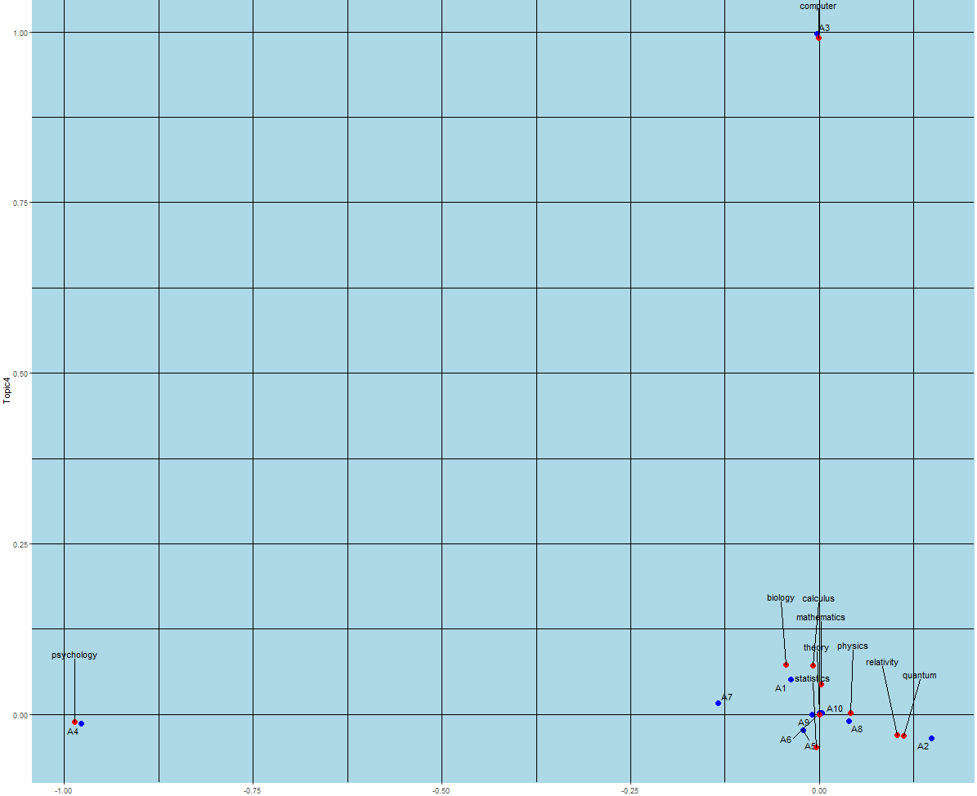
Topic3 vs topic4

Slide 8
Thank you!

